Slide 1
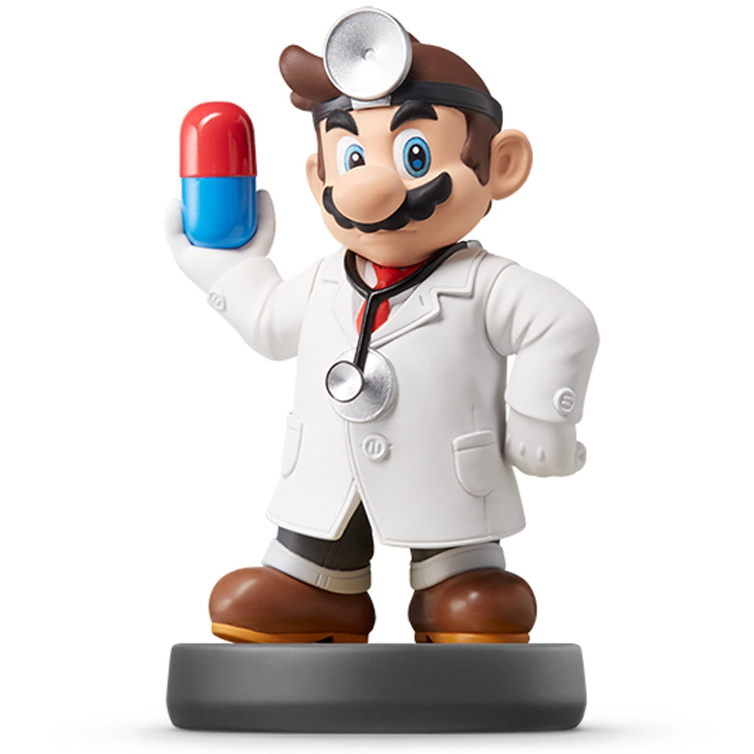
Programming IV

Slide 2
Statistical Programming Assignment
Instructions
Download Analysis 3 Zip Folder
Unzip Folder
Open Analysis 3 Rmd File
Knit to HTML
Read Introduction
Three Part Assignment
Using Climate Data from Delhi
Found on Kaggle
Split Into Train and Test
Daily Data Sorted by Date
Train: 2013-2016
Test: 2017

Slide 3
Statistical Programming Assignment
Play Close Attention
Notice: DO NOT CHANGE
Notice: COMPLETE
Notice: EVAL=F
Coding Restrictions
You Must Use If-Else When Asked or Lose Points
You Must Use Loops When Asked or Lose Points

Slide 4
Part 1 Cleaning Data
Process of Programming
Create Code for a Task
Check Code Works
Create a Function of the Process to Generalize
Question 1
Taking Working Code and Create a Function
Apply Function to Train
Apply Function to Test
Use Copy and Paste with Some Minor Changes

Slide 5
Part 1 Cleaning Data
Question 2
Change Month from Numbers to Names
Create Function to convert a Vector of Months in Number to a Vector of Months in Name
Alternative for Variable Creation
Question 3
Look at Use of Function
Rewrite Over Day Variable with Day Names
Data Organized by Date and Starts with a Tuesday
Do this For Train and Test
Data$NEWVAR = CONTENT

Slide 6
Part 1 Cleaning Data
Question 4
Convert Celsius to Fahrenheit
Google Conversion Formula
Function that Changes Vector of Celsius Temperatures to Vector of Fahrenheit Temperatures

Slide 7
Part 2 Summarizing Data
Question 1
Use a Double Loop
Building a 12x7 Table
Start with NA’s
Imputing the Mean Temperature for Each Month and Day
Run This and Think:
Question 2
Create Function that Computes Range
Do Not Use print() in Function
rownames(MEAN.TEMP.TRAIN)[4]
colnames(MEAN.TEMP.TRAIN)[6]

Slide 8
Part 2 Summarizing Data
Question 3
Apply() Function to Matrix
To Rows
To Columns
Question 4
Loop Through All Observations
Start with NULL to Create Vector of Humidity
Explain Results from t-Test in the Context of the Problem
apply(Matrix, 1, Function)
apply(Matrix, 2, Function)

Slide 9
Part 3 Time Series Variables
Question 1
Create Percent Change
Use a Loop To Create
Look Back at Original Lag Function from Lecture
Question 2
Create Moving Average
Similar Process to First Question

Slide 10
Closing
Disperse and Make Reasonable Decisions

